Slide 1
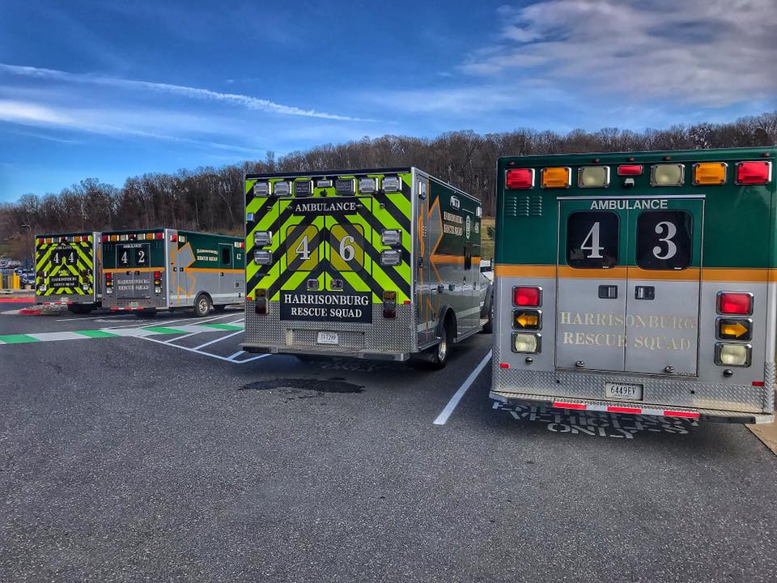
Falls in EMS
Harrisonburg Rescue Squad, Inc.
Lindsey Stein, MS, NRP, FP-C

Slide 2
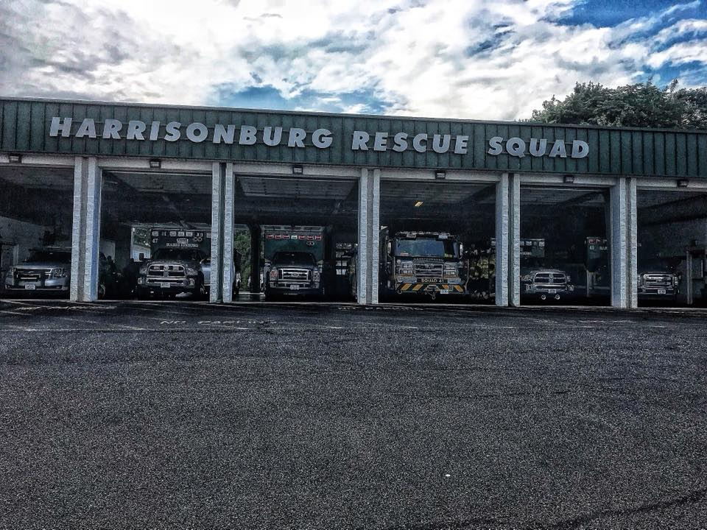
About HRS
100% volunteer EMS agency
All of Harrisonburg, parts of Rockingham County
9 ambulances, heavy rescue, rehab vehicle, SERVs
~25 calls/day, ~9,000/year
One of the busiest stations in the state
One of the last all-volunteer stations

Slide 3
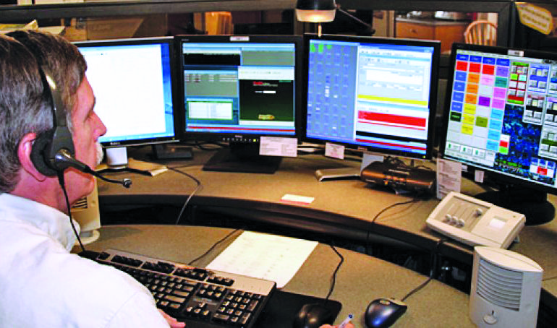
Call Types
Chest pain
Difficulty breathing
Stroke
Seizure
Traffic crash
Traumatic injury
OB events
Pain
Fever
FALLS = one of most frequent

Slide 4
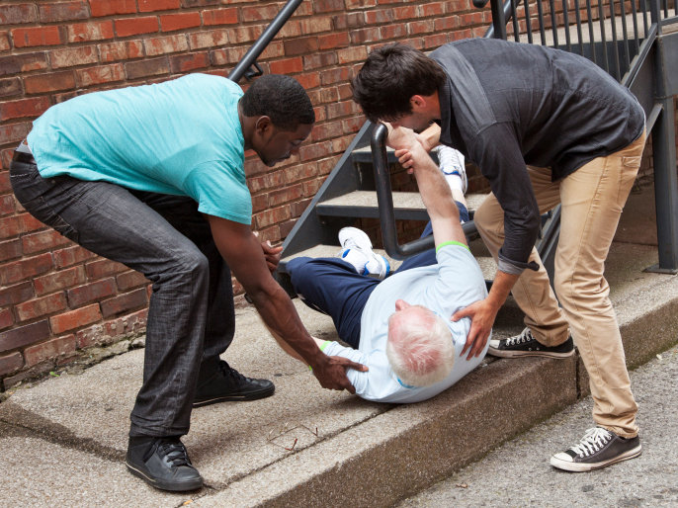
Falls in EMS: Demographics
Most common:
Elderly population
Live alone
Live with spouse who cannot help
Lacking in assistance
Preexisting health problems
Other: weather-related

Slide 5
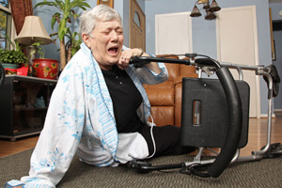
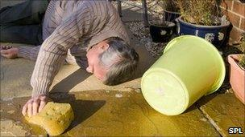
Falls in EMS: Causes
Extrinsic
Slippers, carpets, steps
Intrinsic
Dizziness, weakness, syncope
MI, stroke, seizure, sepsis
Injury/illness vs. lift assist

Slide 6
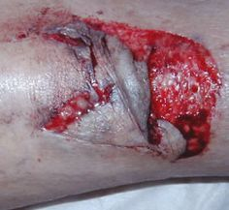
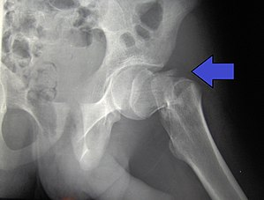
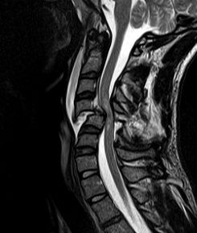
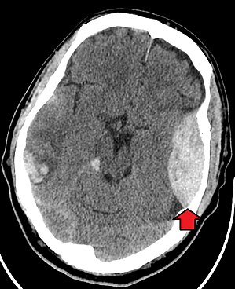
Injuries
Ground level falls → debilitating with age
Musculoskeletal, head injuries
Risk factors: osteoporosis, blood thinners
Hip injuries, femoral head, spinal fractures, head bleeds, skin tears
Broken ribs → pneumonia
Small fall → big impact on health, finances

Slide 7
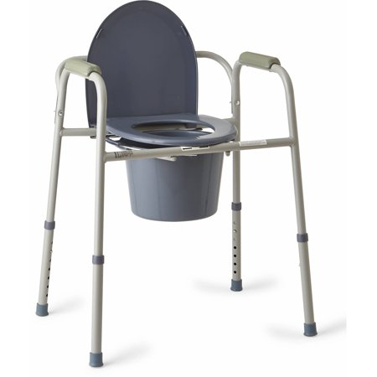
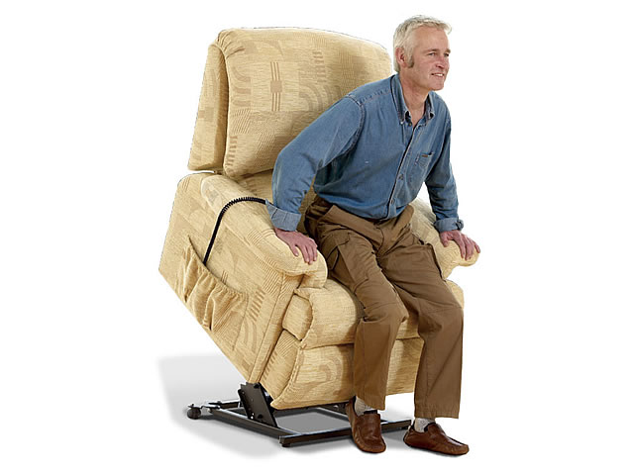
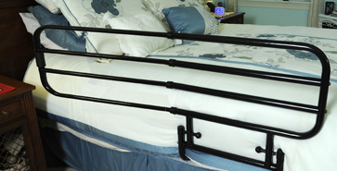
Reducing Falls
Education regarding extrinsic causes
Fall alert pendants
Bedside toilets
Resources for home health
Encouraging friends/neighbors/family to get involved
Standing recliners
Beds with railings
Severe cases – APS

Slide 8
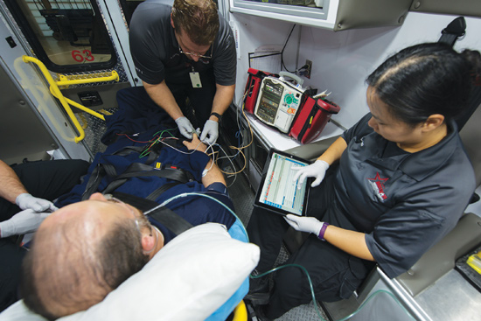
EMS’ Continuing Role
Priority: provide necessary medical care
Training on intrinsic cause recognition
Consider what’s best for patient – transport vs. lift assist
Eliminate extrinsic risks where possible
Offer lifestyle suggestions when appropriate
Inform ER of home situation if not well-suited for injury

